Slide 1
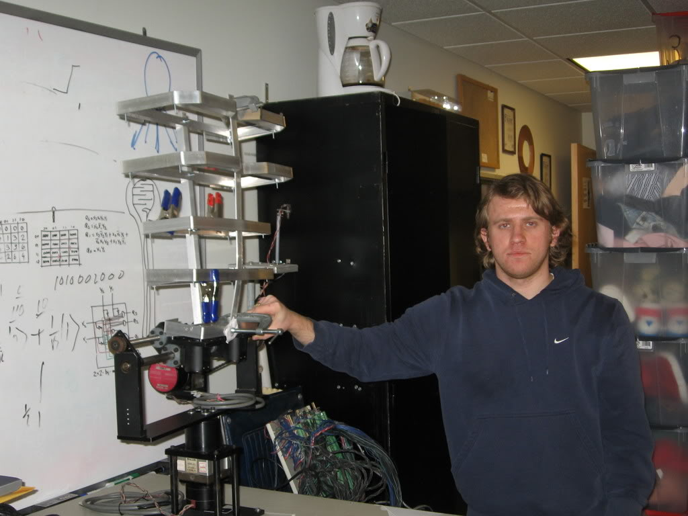
QUANTUM ROBOTICS IN ROBOT THEATRE

Slide 2
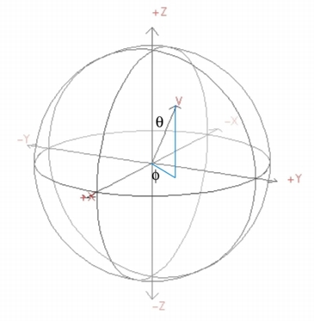
Quantum Signals and Automata
Binary Logic
0, 1
Fuzzy Logic
[0,1]
Quantum
Logic
Hilbert Space, Bloch Sphere

Slide 3
Quantum Signals and Automata
Logic circuit
Quantum array
Finite State Machine
Quantum state Machine
Algorithm
Quantum Algorithm

Slide 4
Quantum Robot Theatre
Quantum
Computing
Intelligent
Robotics
Since 1999
Since 1969
Quantum
Robotics
Since 2004

Slide 5
Quantum
Robotics
Constraint Satisfaction Model for Grover Algorithm
Collaboration:
Martin Lukac, Michitaka Kameyama, Tohoku University,
Quantum Robot Vision
Vamsi Parasa, Erik Paul
Quantum Fuzzy Logic
Arushi Raghuvanshi
Michael Miller, Univ. Victoria, BC
Quantum Braitenberg
Vehicles
Siddhar Manoj
Arushi Raghuvanshi
Quantum Emotions
Martin Lukac
Quantum Initialization and Neural Networks
David Rosenbaum

Slide 6
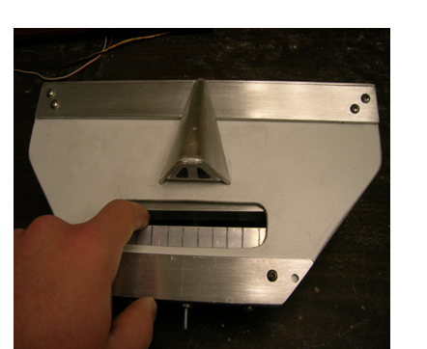
The first quantum robot in the world?

Slide 7
Our concept of quantum robot
based on reducing all problems to constraint satisfaction solved on a quantum computer

Slide 8
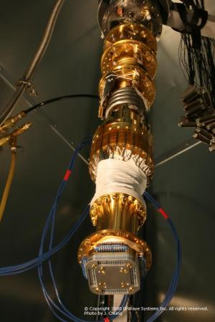
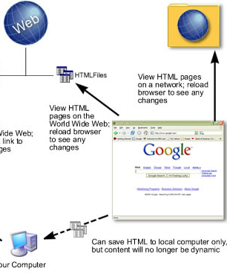
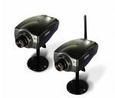

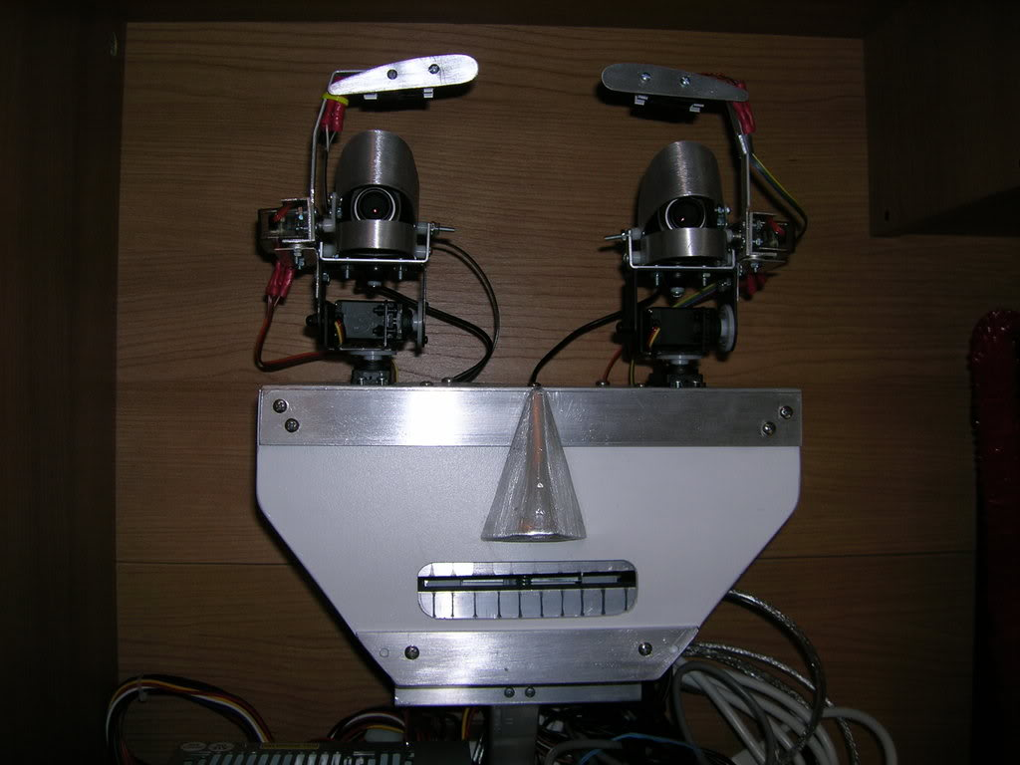


The whole proposed PSU Quantum Robot system
Orion Quantum Adiabatic Computer in Vancouver BC, Canada
Orion interface
PC
Personal computer
Bluetooth connection
CUDA/GPU supercomputer

Slide 9
QUBOT-1 – the world’s first quantum robot

Slide 10
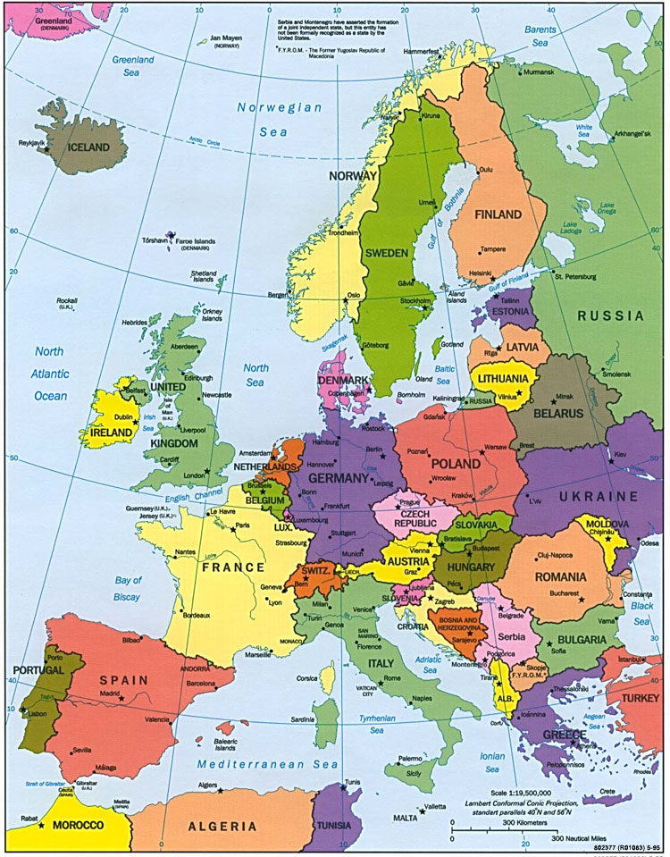
Oracle for Quantum Map of Europe Coloring
Germany
France
Switzerland
Spain
Spain
France
Germany
Quaternary qudits
Switzerland
Multiple-Valued Quantum Circuits
≠
≠
≠
≠
Good coloring

Slide 11
Constraint Satisfaction Problem is to satisfy the constraints and minimize the energy
Germany
France
Switzerland
Spain
Spain
France
Germany
Constraints to be satisfied
Switzerland
≠
≠
≠
≠
Good coloring
Energy to be minimized
Count number of ones
Adiabatic Quantum Computer

Slide 12
Constraints Satisfaction Problems
S E N D
+ M O R E
M O N E Y
Cryptographic Problems
Graph coloring

Slide 13
Constraint Satisfaction for Robotics
Insufficient speed of robot image processing and pattern recognition.
  This can be solved by special processors, DSP processors, FPGA architectures and parallel computing.
Prolog allows to write CSP programs very quickly.
An interesting approach is to formulate many problems using the same general model.
This model may be predicate calculus, Satisfiability, Artificial Neural Nets or Constraints Satisfaction Model.
  Constraints to be satisfied (complex formulas in general)
  Energies to be minimized (complex formulas)

Slide 14
SAT as a constraint satisfaction problem
(a + b’ + c) * (b + d’) … = 1
Highly parallel system of updating nodes
c
=1
=0
=1
a
b
d
=1
(a + b’ + c)
(b + d’)
Yes , do nothing to nodes
No , update nodes

Slide 15
SAT as a constraint satisfaction problem
(a + b’ + c) * (b + d’) … = 1
Constraints:
(a + b’ + c) = 1
(b + d’) = 1
…..
Orion programming is just writing equations for constraints and equations for energy
Energy optimization:
(a + b’ + c) = f1
(b + d’) = f2
….
Min ( f1’ + f2’ + …..)

Slide 16
Conditional robot response based on camera input
This one is really cool.
At a high level the way it works is as follows.
You have a camera trained on a human. The data taken by the camera is processed so as to detect features, which are generalized patterns of behavior.
For example, a feature detector could be configured to detect the presence of anger in the human, for example by learning-based methods.
In addition, there is a robot, which is connected to the data processing system connected to the camera.
This robot has effectors which control its actions.
In this application, the effector controls are functions of the processed input from the camera, where the rules connecting the two are user-determined.

Slide 17
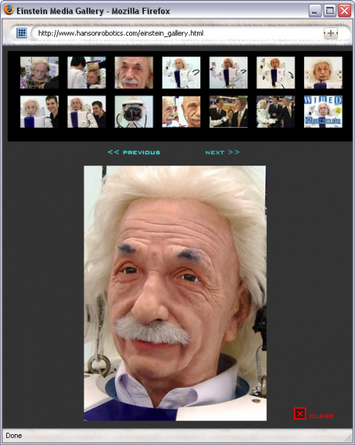
This generic situation, where the robot’s behavior is conditioned upon the input from the feature detectors connected to the camera, maps to a constraint satisfaction problem as described here.
The way this would work is that the human / camera / robot system would generate optimization and satisfiability problems, to determine how the robot’s effectors should fire, and these problems can be remotely solved using Orion.
For example, you could acquire a Hansen Robotics Einstein, sit it him on your desk, train a camera on your face, use an anger feature detector that causes the Einstein robot to laugh harder the angrier you get.

Slide 18
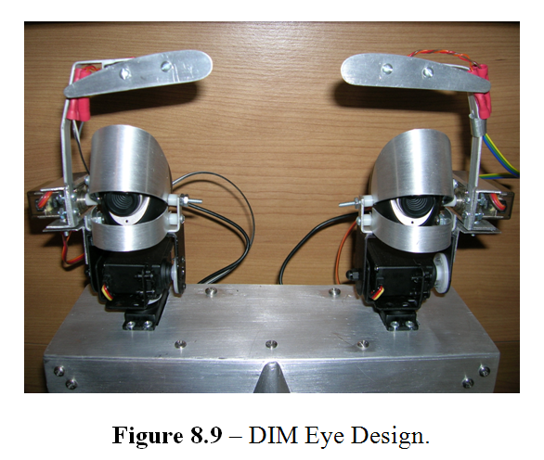

Slide 19
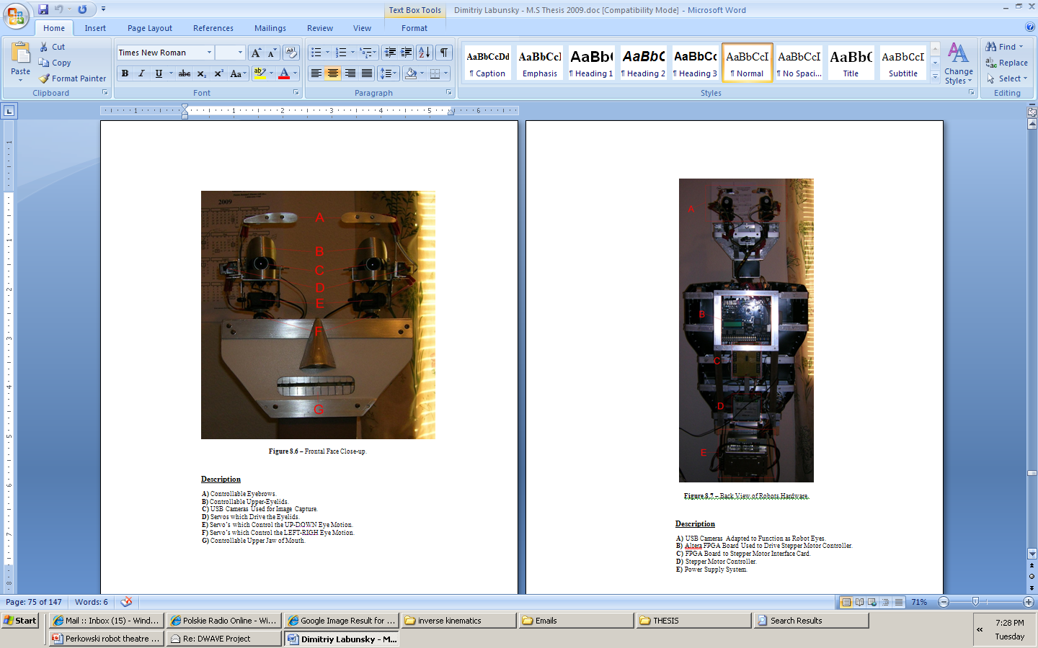

Slide 20
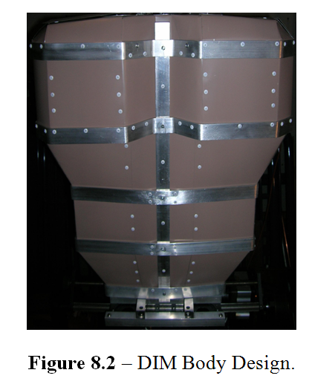

Slide 21
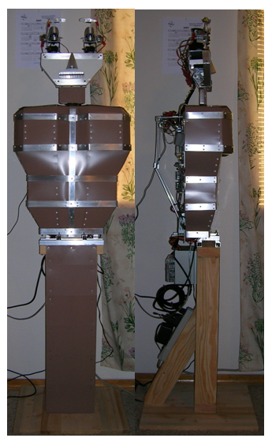

Slide 23
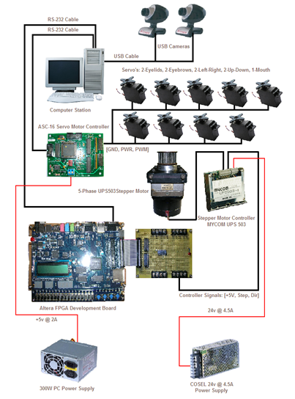
High Level Schematic of DIM robot

Slide 24
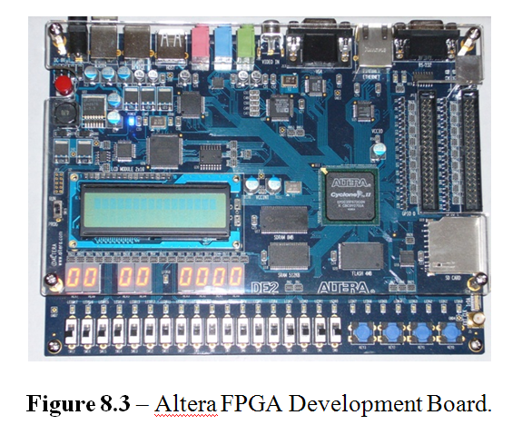

Slide 25
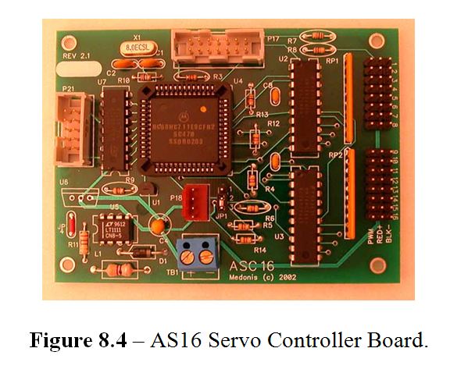

Slide 26
Many research and teaching areas
My robotics classes and topics of theses are much broader than in other universities:
Classical Robotics
Speech synthesis and analysis
Robot vision
  Face recognition and tracking,
  gesture recognition, etc.
Motion generation
Dialog and natural language
Scripts and agents.
Search and Machine Learning.
  Search theory
  Decision trees and constructive induction (AC decomposition)
  CSP
  Pattern Recognition
New models:
  Probabilistic robotics,
  Quantum Robotics,
  Developmental Robotics.

Slide 27
Many partial practical projects, broad range of technical knowledge
Controllers and processors
FPGA and PLD, VHDL and Verilog.
CUDA and GPU
Motors and sensors
RobotC, C, C++, Prolog, LISP, PYTHON, etc.
Writing requirements
Creativity and invention.
Integration of engineering, science and art.
Many awards for high school students.

Slide 28
Conclusions
Our goals are to both create a model innovative robot theatre and a theory of robot theatre that would be similar to the theory of film or theory of interactive computer games.
We believe that robot theatre will become a new art form and we are interested what are the basic questions related to the art of performing robots.
We hope to have an interesting feedback to our ideas from the System Science oriented researchers.

Slide 29
Questions:
Will Robot theatre be ever as popular art form as film or theatre?
Will robots be popularly used in theatres?
Will we see robot theatre toys?
Will home robots be also entertainers?

Slide 30
New Research Area or only application?
What is Robot Theatre Theory?
What are its main methods?
How to evaluate Robot Theatres.
Is robot theatre only an application of robotics or is it more? What ?
We see that humans can laugh looking at our theatre.
Will we ever experience humans crying at robot performances?
What can we learn from robot theatre that is not a standard robotics problem?

